Slide 1

NAME :-RAHUL MANOJ MANDAL COURSE NAME:- DATA SCIENCE BATCH :- 1st JUNE
IPL AUCTION STRATEGY AND DATA

Slide 2
TABLE CREATE AND IMPORT DATABASE
create table ipl_match(id int,city varchar(20),match_date date,player_of_match varchar(20),
venue varchar(80),neutral_venue int,
team1 varchar(30),team2 varchar(30),toss_winner varchar(30),toss_decision varchar(20),
winner varchar(30),result varchar(20),
result_margin int,eliminator varchar(20),method varchar(20),umpire1 varchar(50),umpire2 varchar(50));
create table ipl_player_data(id int,inning int,over int,ball int,batsman varchar(50),non_striker varchar(50),
bowler varchar(50),batsman_runs int,extra_runs int,total_runs int,is_wicket int,
dismissal_kind varchar(50),player_dismissed varchar(50),
fielder varchar(50),extras_type varchar(50),batting_team varchar(50),bowling_team varchar(50)
);
copy ipl_match from 'C:\Program Files\PostgreSQL\16\data\IPL Dataset\IPL Dataset\IPL_matches.csv' csv header;
copy ipl_player_data from 'C:\Program Files\PostgreSQL\16\data\IPL Dataset\IPL Dataset\IPL_BALL.csv' delimiter ',' csv header;
select * from ipl_match;
select * from ipl_player_data;

Slide 3
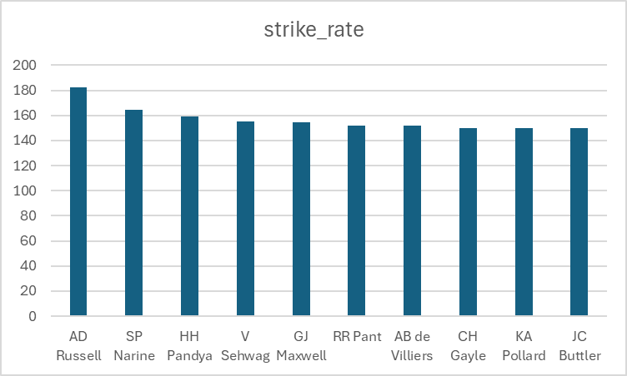
Your first priority is to get 2-3 players with high S.R who have faced at least 500 balls And to do that you have to make a list of 10 players you want to bid in the auction so that when you try to grab them in auction you should not pay the amount greater than you have in the purse for a particular player.
BEST STRIKER BATSMAN
batsman | strike_rate
AD Russell | 182.3317308
SP Narine | 164.2725599
HH Pandya | 159.2680047
V Sehwag | 155.4415954
GJ Maxwell | 154.676259
RR Pant | 151.9736842
AB de Villiers | 151.9110276
CH Gayle | 150.1100975
KA Pollard | 149.8760535
JC Buttler | 149.5636998
QUERY
select batsman,cast(sum(batsman_runs) as float)/sum(case when extras_type!='wides' then 1 else 0 end)*100 as strike_rate from ipl_player_data where extras_type!='wides' group by batsman
having sum( case when extras_type!='wides' then 1 else 0 end)>500
order by strike_rate desc limit 10;

Slide 4

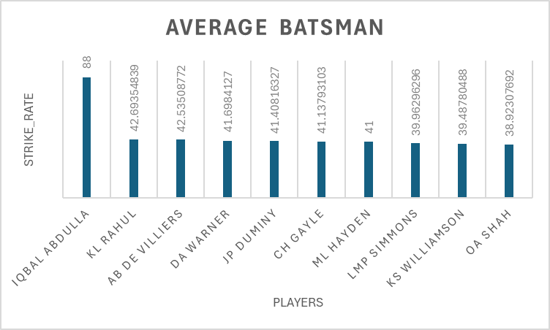
AVERAGE STRIKE bATSMAN Now you need to get 2-3 players with good Average who have played more than 2 ipl seasons. And to do that you have to make a list of 10 players you want to bid in the auction so that when you try to grab them in auctin you should not pay the amount greater than you have in the purse for a particular player.
Query :- select a.batsman ,(sum(batsman_runs)*1.0/sum(case when is_wicket=1 then is_wicket end)) as average from ipl_player_data as a left join ipl_match as b on a.id=b.id group by a.batsman having count(distinct(extract(year from match_date)))>2 order by average desc limit 10;
batsman | average
Iqbal Abdulla | 88
KL Rahul | 42.69355
AB de Villiers | 42.53509
DA Warner | 41.69841
JP Duminy | 41.40816
CH Gayle | 41.13793
ML Hayden | 41
LMP Simmons | 39.96296
KS Williamson | 39.4878
OA Shah | 38.92308

Slide 5
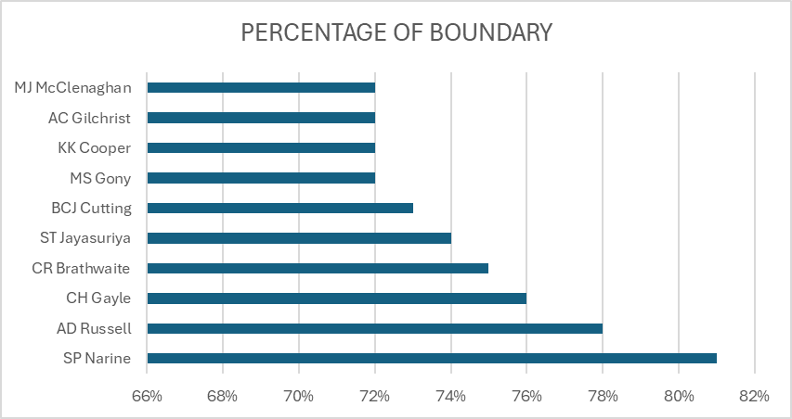
HARD HITTING BATSMAN
Now you need to get 2-3 Hard-hitting players who have scored most runs in boundaries and have played more the 2 ipl season. To do that you have to make a list of 10 players you want to bid in the auction so that when you try to grab them in auction you should not pay the amount greater than you have in the purse for a particular player.
QUERY:- select a.batsman,sum(case when a.batsman_runs in (4,6) then 1 else 0 end) as boundaries,sum(a.batsman_runs) as total_runs,
concat((sum(case when a.batsman_runs in (4,6) then a.batsman_runs else 0 end)*100)/(sum(a.batsman_runs)),'%') as percentage_of_boundry
from ipl_player_data as a left join ipl_match as b on b.id=a.id
group by a.batsman having count(distinct(extract(year from match_date)))>2 order by percentage_of_boundry desc limit 10;
batsman | total_runs | Percentage_of_boundry
SP Narine | 892 | 81%
AD Russell | 1517 | 78%
CH Gayle | 4772 | 76%
CR Brathwaite | 181 | 75%
ST Jayasuriya | 768 | 74%
BCJ Cutting | 238 | 73%
MS Gony | 99 | 72%
KK Cooper | 116 | 72%
AC Gilchrist | 2069 | 72%
MJ McClenaghan | 85 | 72%

Slide 6
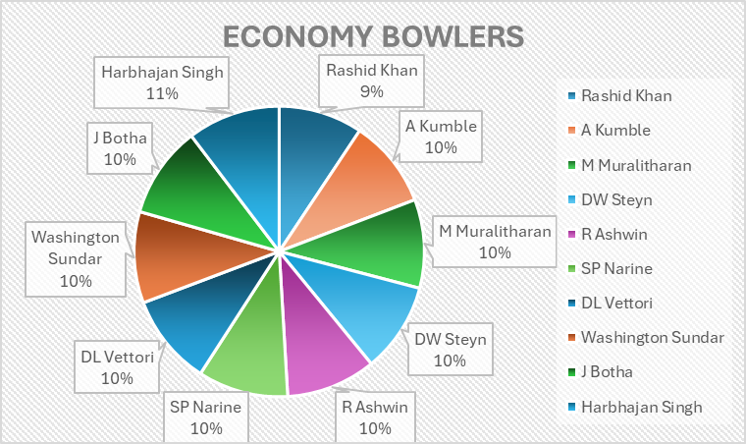
GOOD ECONOMY BOWLERS
bowler | economy
Rashid Khan | 6.342741935
A Kumble | 6.680981595
M Muralitharan | 6.698473282
DW Steyn | 6.775725594
R Ashwin | 6.779783394
SP Narine | 6.825531915
DL Vettori | 6.876923077
Washington Sundar | 6.890909091
J Botha | 6.93220339
Harbhajan Singh | 7.022608696
QUERY:-
select a.bowler,(cast((total_runs)as decimal(10,2))/(overs))as economy from (select bowler,sum(total_runs)as total_runs,
count(ball)/6 as overs from ipl_player_data
group by bowler having count(ball)>500) as a
order by economy asc limit 10;
Your first priority is to get 2-3 bowlers with good economy who have bowled at least 500 balls in IPL so far.To do that you have to make a list of 10 players you want to bid in the auction so that when you try to grab them in auction you should not pay the amount greater than you have in the purse for a particular player.

Slide 7
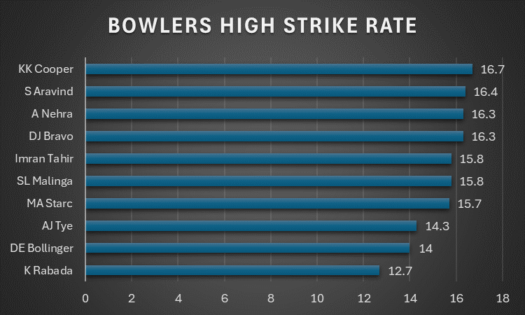
HIGH STRIKE BOWLERS
bowler | strike_rate | dense_rank
K Rabada | 12.7 | 1
DE Bollinger | 14 | 2
AJ Tye | 14.3 | 3
MA Starc | 15.7 | 4
SL Malinga | 15.8 | 5
Imran Tahir | 15.8 | 6
DJ Bravo | 16.3 | 7
A Nehra | 16.3 | 8
S Aravind | 16.4 | 9
KK Cooper | 16.7 | 10
QUERY:-
select bowler,cast(strike_rate as decimal(3,1)),dense_rank() over(order by strike_rate) from (select bowler,cast((total_balls) as decimal(10,2))/(wickets) as strike_rate from( select bowler,total_balls,sum(is_wicket)as wickets from (
select bowler,is_wicket,count(ball) over (partition by bowler)as total_balls from ipl_player_data)as a where total_balls>500 and is_wicket>0 group by bowler,total_balls )as b )as c limit 10;
Now you need to get 2-3 bowlers with the best strike rate and who have bowled at least 500 balls in IPL so far.To do that you have to make a list of 10 players you want to bid in the auction so that when you try to grab them in auction you should not pay the amount greater than you have in the purse for a particular player.

Slide 8
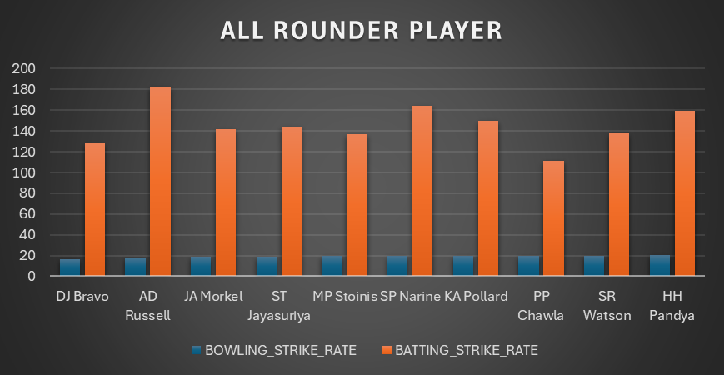
ALL ROUNDER PLAYERS
player | bowling_strike_rate | batting_strike_rate
DJ Bravo | 16.3 | 128.2271945
AD Russell | 17.7 | 182.3317308
JA Morkel | 18.8 | 141.9825073
ST Jayasuriya | 18.8 | 144.3609023
MP Stoinis | 19.4 | 137.2712146
SP Narine | 19.7 | 164.2725599
KA Pollard | 19.9 | 149.8760535
PP Chawla | 20 | 111.4503817
SR Watson | 20 | 137.9138483
HH Pandya | 20.3 | 159.2680047
QUERY :-
SELECT m.player,bowling_strike_rate,batting_strike_rate FROM (SELECT bowler AS player, CAST(strike_rate AS DECIMAL(3,1)) AS bowling_strike_rate FROM (
SELECT bowler, CAST(total_balls AS DECIMAL(10,2)) / wickets AS strike_rate FROM ( SELECT bowler, total_balls, SUM(is_wicket) AS wickets FROM (
SELECT bowler,is_wicket,COUNT(ball) OVER (PARTITION BY bowler) AS total_balls FROM ipl_player_data) AS a WHERE total_balls > 300 AND is_wicket > 0
GROUP BY bowler, total_balls) AS b) AS c ) AS m
INNER JOIN (
SELECT batsman AS player, CAST(SUM(batsman_runs) AS FLOAT) / COUNT(ball) * 100 AS batting_strike_rate FROM ipl_player_data WHERE extras_type != 'wides'
GROUP BY batsman HAVING COUNT(ball) > 500) AS n ON m.player = n.player
ORDER BY m.bowling_strike_rate, n.batting_strike_rate limit 10;
Now you need to get 2-3 All_rounders with the best batting as well as bowling strike rate and who have faced at least 500 balls in IPL so far and have bowled minimum 300 balls.To do that you have to make a list of 10 players you want to bid in the auction so that when you try to grab them in auction you should not pay the amount greater than you have in the purse for a particular player.

Slide 9
WICKETKEEPER
PLAYER SHOUD HAVE PLAYED MORE THAN 2 IPL SEASON AND FACE BALLS>300
HAVING BOWLING STRIKE RATE <9
HAVING BATTING STRIKE RATE <120
BALL SERVER MORE THAN 300
SELECT m.player,bowling_strike_rate,batting_strike_rate FROM (SELECT bowler AS player, CAST(strike_rate AS DECIMAL(3,1)) AS bowling_strike_rate FROM (
SELECT bowler, CAST(total_balls AS DECIMAL(10,2)) / wickets AS strike_rate FROM ( SELECT bowler, total_balls, SUM(is_wicket) AS wickets FROM (
SELECT bowler,is_wicket,COUNT(ball) OVER (PARTITION BY bowler) AS total_balls FROM ipl_player_data) AS a WHERE total_balls > 300 AND is_wicket > 0
GROUP BY bowler, total_balls) AS b) AS c ) AS m
INNER JOIN (
SELECT batsman AS player, CAST(SUM(batsman_runs) AS FLOAT) / COUNT(ball) * 100 AS batting_strike_rate FROM ipl_player_data WHERE extras_type != 'wides'
GROUP BY batsman HAVING COUNT(ball) > 300) AS n ON m.player = n.player
WHERE bowling_strike_rate<9 OR batting_strike_rate>120
ORDER BY m.bowling_strike_rate, n.batting_strike_rate limit 2;

Slide 10
CREATE TABLE MATCHES AND DELIVERIES
create table matches(id int,city varchar(20),match_date date,player_of_match varchar(20),
venue varchar(80),neutral_venue int,
team1 varchar(30),team2 varchar(30),toss_winner varchar(30),toss_decision varchar(20),
winner varchar(30),result varchar(20),
result_margin int,eliminator varchar(20),method varchar(20),umpire1 varchar(50),umpire2 varchar(50));
copy matches from 'C:\Program Files\PostgreSQL\16\data\IPL Dataset\IPL Dataset\IPL_matches.csv' csv header;
create table Deliveries(id int,inning int,over int,ball int,batsman varchar(50),non_striker varchar(50),
bowler varchar(50),batsman_runs int,extra_runs int,total_runs int,is_wicket int,
dismissal_kind varchar(50),player_dismissed varchar(50),
fielder varchar(50),extras_type varchar(50),batting_team varchar(50),bowling_team varchar(50)
);
copy Deliveries from 'C:\Program Files\PostgreSQL\16\data\IPL Dataset\IPL Dataset\IPL_BALL.csv' delimiter ',' csv header;

Slide 11
ADDITION QUESTION
1. Get the count of cities that have hosted an IPL match
TOTAL_CITY
816
QUERY :- select count(city) AS TOTAL_CITY from matches;
2. Create table deliveries_v02 with all the columns of the table ‘deliveries’ and an additional column ball_result containing values boundary, dot or other depending on the total_run (boundary for >= 4, dot for 0 and other for any other number)
QUERY
create table deliveries_v02 as (
select *,case
when batsman_runs in (4,6) then 'boundary'
when batsman_runs=0 then 'dot'
else 'other' end ball_type
from Deliveries
);

Slide 12
ADDITION QUESTION
3. Write a query to fetch the total number of boundaries and dot balls from the deliveries_v02 table.
QUERY:- select ball_type,count(ball_type) from deliveries_v02
where ball_type='boundary' or ball_type='dot'
group by ball_type;
ball_type | count
boundary | 30810
dot | 77637
batting_team | total_boundary
Mumbai Indians | 4034
Royal Challengers Bangalore | 3729
Kings XI Punjab | 3698
Kolkata Knight Riders | 3637
Chennai Super Kings | 3424
Rajasthan Royals | 2983
Delhi Daredevils | 2955
Sunrisers Hyderabad | 2260
Deccan Chargers | 1357
Pune Warriors | 721
Delhi Capitals | 649
Gujarat Lions | 615
Rising Pune Supergiant | 286
Rising Pune Supergiants | 239
Kochi Tuskers Kerala | 223
4. Write a query to fetch the total number of boundaries scored by each team from the deliveries_v02 table and order it in descending order of the number of boundaries scored.
QUERY :- select batting_team,count(ball_type) as total_boundary from
deliveries_v02 where ball_type='boundary'
group by batting_team order by total_boundary desc;

Slide 13
ADDITION QUESTION
dismissal_kind | total_dismissals
bowled | 1700
caught | 5743
caught and bowled | 269
hit wicket | 12
lbw | 571
NA | 183973
obstructing the field | 2
retired hurt | 11
run out | 893
stumped | 294
6. Write a query to fetch the total number of dismissals by dismissal kinds where dismissal kind is not NA​
​
QUERY :- select dismissal_kind,count(dismissal_kind) total_dismissals from deliveries_v02​
group by dismissal_kind;
8. Write a query to create a table named deliveries_v03 with all the columns of deliveries_v02 table and two additional column (named venue and match_date) of venue and date from table matches
QUERY:- create table deliveries_v03 as (select b.*,a.venue as venue,a.match_date as date from deliveries_v02 as b full join
matches as a on a.id=b.id);

Slide 14
ADDITION QUESTION
5. Write a query to fetch the total number of dot balls bowled by each team and order it in descending order of the total number of dot balls bowled.
QUERY :- select bowling_team,count(ball_type)as total_dot_ball from
deliveries_v02 where ball_type='dot'
group by bowling_team
order by total_dot_ball desc;
bowling_team | total_dot_ball
Mumbai Indians | 10005
Royal Challengers Bangalore | 9196
Kolkata Knight Riders | 8994
Kings XI Punjab | 8855
Chennai Super Kings | 8615
Rajasthan Royals | 7734
Delhi Daredevils | 7470
Sunrisers Hyderabad | 5868
Deccan Chargers | 3805
Pune Warriors | 2114
Delhi Capitals | 1514
Gujarat Lions | 1252
Rising Pune Supergiant | 797
Kochi Tuskers Kerala | 713
Rising Pune Supergiants | 618
NA | 87
7. Write a query to get the top 5 bowlers who conceded maximum extra runs from the deliveries table
QUERY:- select * from deliveries_v02;
select * from matches;
bowler | maximum_extra_runs
SL Malinga | 293
P Kumar | 236
UT Yadav | 226
DJ Bravo | 210
B Kumar | 201

Slide 15
venue | venue_total_run |  | venue | venue_total_run
Eden Gardens | 23658 |  | Sardar Patel Stadium, Motera | 3746
Wankhede Stadium | 23390 |  | SuperSport Park | 3653
Feroz Shah Kotla | 22947 |  | Saurashtra Cricket Association Stadium | 3316
M Chinnaswamy Stadium | 20237 |  | Himachal Pradesh Cricket Association Stadium | 2897
Rajiv Gandhi International Stadium, Uppal | 19484 |  | Holkar Cricket Stadium | 2872
MA Chidambaram Stadium, Chepauk | 17821 |  | New Wanderers Stadium | 2292
Sawai Mansingh Stadium | 14264 |  | Barabati Stadium | 2278
Punjab Cricket Association Stadium, Mohali | 10987 |  | JSCA International Stadium Complex | 2056
Dubai International Cricket Stadium | 10402 |  | St George's Park | 2033
Sheikh Zayed Stadium | 8830 |  | Newlands | 1764
Punjab Cricket Association IS Bindra Stadium, Mohali | 7021 |  | Shaheed Veer Narayan Singh International Stadium | 1741
Maharashtra Cricket Association Stadium | 6780 |  | Nehru Stadium | 1363
Sharjah Cricket Stadium | 5924 |  | Green Park | 1298
M.Chinnaswamy Stadium | 5127 |  | De Beers Diamond Oval | 897
Dr DY Patil Sports Academy | 4810 |  | Vidarbha Cricket Association Stadium, Jamtha | 882
Subrata Roy Sahara Stadium | 4755 |  | Buffalo Park | 799
Kingsmead | 4353 |  | OUTsurance Oval | 529
Brabourne Stadium | 3842
Dr. Y.S. Rajasekhara Reddy ACA-VDCA Cricket Stadium | 3746
ADDITION QUESTION
9. Write a query to fetch the total runs scored for each venue and order it in the descending order of total runs scored.
QUARY:- select venue,sum(total_runs) as venue_total_run from deliveries_v03
group by venue order by venue_total_run desc;

Slide 16
ADDITION QUESTION
match_year | total_run
2018 | 2885
2019 | 2651
2015 | 2386
2013 | 2304
2017 | 2194
2010 | 2167
2016 | 2073
2012 | 2012
2011 | 1854
2008 | 1843
2014 | 1289
10. Write a query to fetch the year-wise total runs scored at Eden Gardens and order it in the descending order of total runs scored.
QUERY:- select distinct extract(year from date) as match_year,sum(total_runs)as total_run
from deliveries_v03 where lower(venue)='eden gardens'
group by match_year
order by total_run desc;

